Slide 1
Title :- Mobile Analytics Dashboard Project
Subtitle :- Real Time Data Insights For Mobile Transactions
Presented By :- Subham Biswas

Slide 2
Title: Project Overview
Developed a real-time mobile analytics dashboard to track and evaluate transaction data.
Designed and implemented a SQL database for efficient data management.
Automated workflows for seamless data import and transformation from CSV files.
Created detailed Power BI visualizations offering insights into customer behavior and spending.

Slide 3
SQL Queries – Key Highlights
Title: Key SQL Queries and Results
1. Price Analysis:
Top 5 most expensive and cheapest phones.
2. Brand-Specific Queries:
Top 5 Samsung phones by features and price.
3. Feature-Specific Analysis:
High and low-priced Android/iOS phones.
4. 5G Analysis:
Top 5 phones supporting 5G.
5. Total Mobile Value:
Summed price of all phones grouped by brand.

Slide 4
Power BI Analysis – Total Mobiles
Title: Key SQL Queries and Results
1. Total Mobiles Analysis
Visual showing the total number of mobiles in the dataset.
Breakdown by brands and operating systems.
2. Mobile Features Analysis
Battery capacity distribution across brands.
Operating system comparison (Android vs. iOS).
3. 5G Availability Analysis
Number and percentage of phones supporting 5G.
Price analysis for 5G-supported phones.
4. Brand Insights Analysis
Brand popularity based on total mobiles listed.
Internal storage and selfie camera trends by brand.

Slide 5
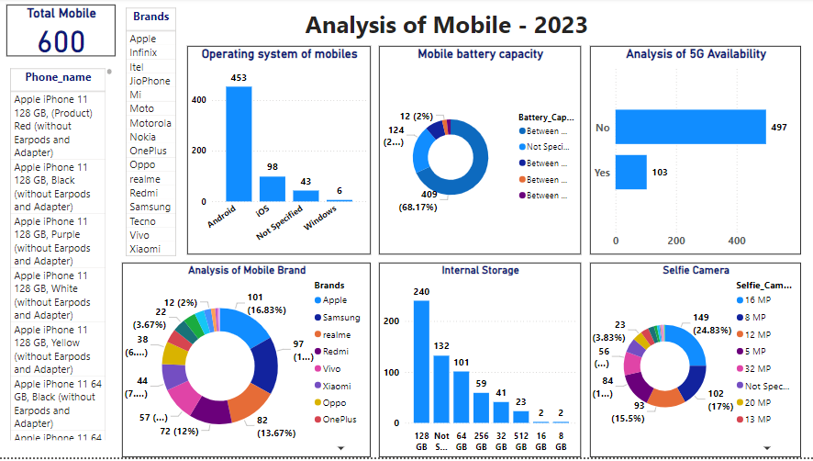
Power BI Dashboard Creation

Slide 6
Title: Conclusion
Successfully developed a comprehensive dashboard for mobile analytics.
SQL queries and Power BI dashboards provide actionable insights.
The analysis supports strategic decision-making in the mobile retail sector.

Slide 7
THANK YOU !

